Slide 1
Software Development Models
Lecturer: Ngo Huy Bien
Software Engineering Department
Faculty of Information Technology
VNUHCM - University of Science
Ho Chi Minh City, Vietnam
nhbien@fit.hcmus.edu.vn

Slide 2
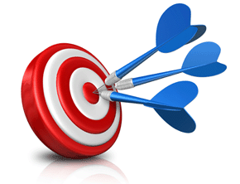
Objectives
To present Waterfall model
To present modified Waterfall models
To present Iterative and Incremental development (IID) model
To present Spiral model
To present Vee model

Slide 3

References
Herbert D. Bennington (1956). Production of Large Computer Programs.
Winston Royce (1970). Managing The Development of Large Software Systems.
Steve Mcconnell (1996). Rapid Development: Taming Wild Software Schedules. Microsoft Press.
Craig Larman (2003). Agile and Iterative Development: A Manager's Guide.
Barry Boehm (1988). A Spiral Model of Software Development and Enhancement.
Nayan B. Ruparelia (2010). Software Development Lifecycle.
Barry Boehm (2000). Spiral Development: Experience, Principles, and Refinements.
Kevin Forsberg and Harold Mooz (1991). The Relationship of System Engineering to the Project Cycle.

Slide 4
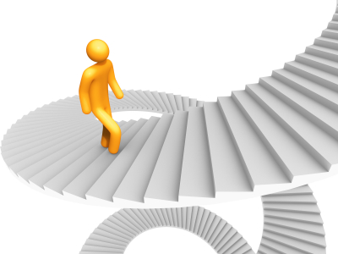
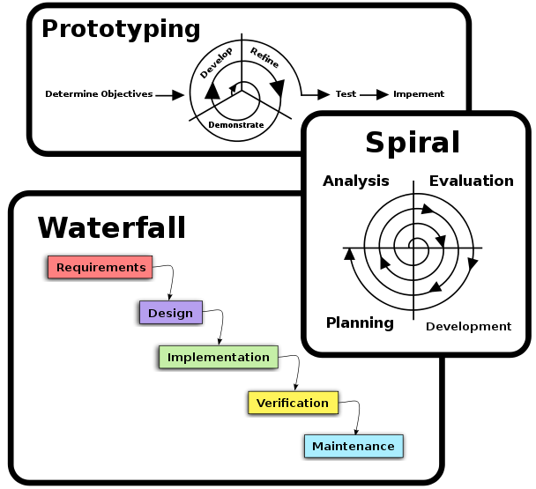
Why Software Development Models?
Which step should we do next?
How long will it take?
How to perform the step?
Which artifacts will it use and produce?
Who is responsible for doing the step?

Slide 5
Notes
Royce (Waterfall, 1970), Boehm (Spiral, 1988), Scrum (Schwaber, 1995), Kruchten (RUP, 1998), Beck (XP, 1999), and Kanban (Anderson, 2010) had no controlled studies. They were experience papers and became landmarks.
Landmark conceptual papers won on conceptual depth, distinctiveness, operational mechanism, and substituted them for evaluation.

Slide 6
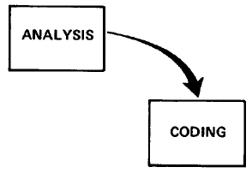
Analysis and Coding [1, 2]
There are two essential steps common to all computer program developments, regardless of size or complexity. There is first an analysis step, followed second by a coding step.
It's the development effort for which most customers are happy to pay, since both steps involve genuinely creative work which directly contributes to the usefulness of the final product.

Slide 7
Code and Fix
Code and Fix is the development method in which you write some code and then fix the problems in the code.
System specification (Optional)
Analyze, Code and Fix
Release (Maybe)
No Overhead (No planning, documentation, QA, standards enforcing, etc., just coding.)
Requires no expertise; anybody can do this.
No way of identifying risk
Poor match to user’s need
Poor structure
No way of accessing quality
Expensive fix
No way of accessing progress

Slide 8
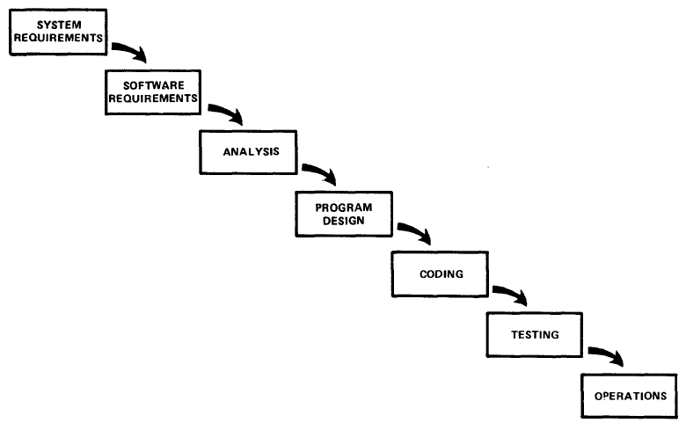
A More Grandiose Approach
In my experience, the simpler model . . . [such as the one pictured in
this slide] has never worked on large software development efforts.

Slide 9
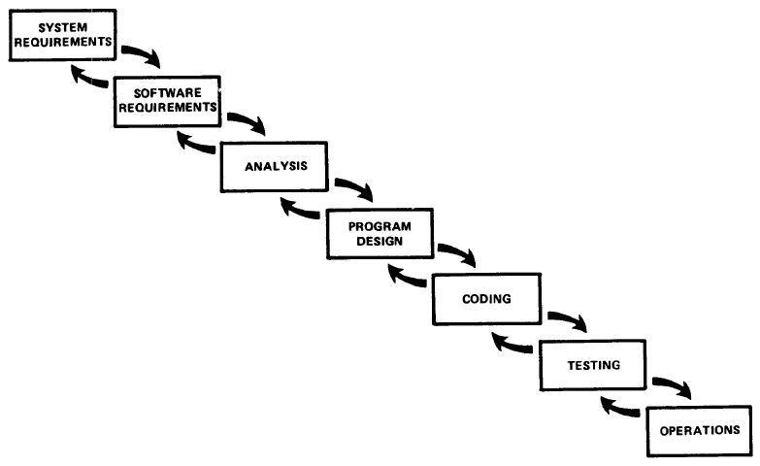
Iterative Relationship Between Successive Phases
As each step progresses and the design is further detailed, there is an iteration with the preceding and succeeding steps but rarely with the more remote steps in the sequence.
As the design proceeds the change process is scoped down to manageable limits.
At any point in the design process
after the requirements analysis is completed there exists a firm and close-up, moving baseline to which to return in the event of unforeseen design difficulties.
What we have is an effective fallback position that tends to maximize the extent of early work that is salvageable and preserved.
Hopefully, the iterative interaction between the various phases is confined to successive steps.

Slide 10
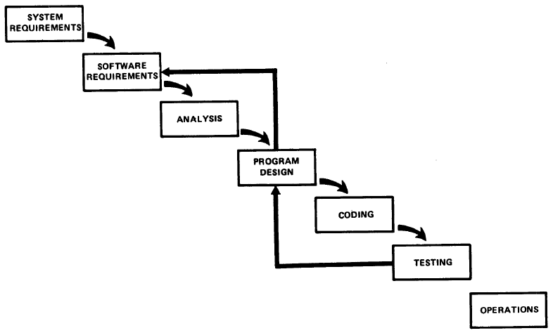
Development Risk
Unfortunately, the design iterations are never confined to the successive steps
Requirements must be modified
A major redesign is required
System fails to satisfy the various external constraints

Slide 11
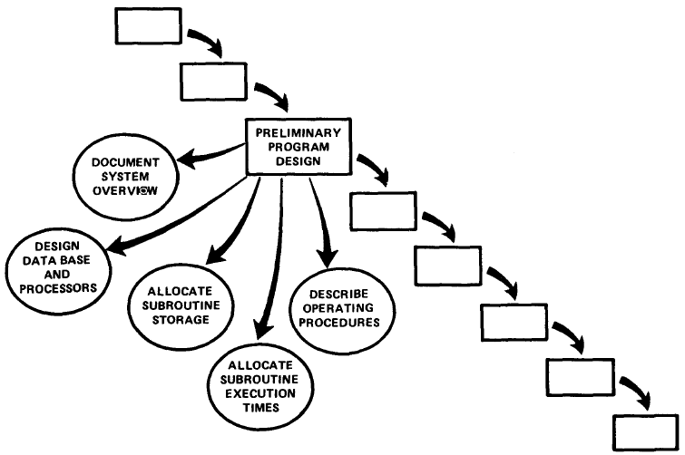
Preliminary Program Design
If something wrong is recognized at this earlier stage, the iteration with requirements and preliminary design can be redone before final design, coding and test commences.
As the analysis proceeds in the succeeding phase the program designer must impose on the analyst the storage, timing, and operational constraints in such a way that he senses the consequences.
Insure that a preliminary program design is complete before analysis begins

Slide 12
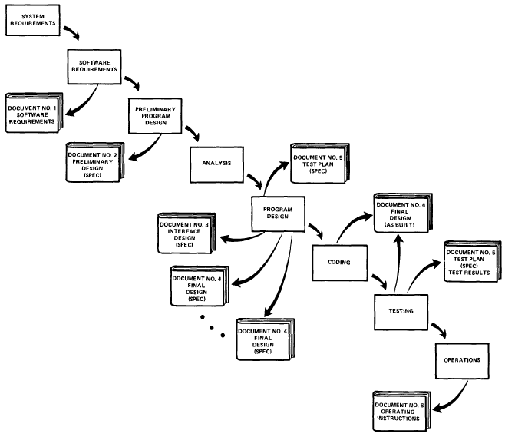
Document The Design
Why so much documentation?
Communication
Quality control
All phases activities support
Redesign support
Insure that documentation is current and complete

Slide 13
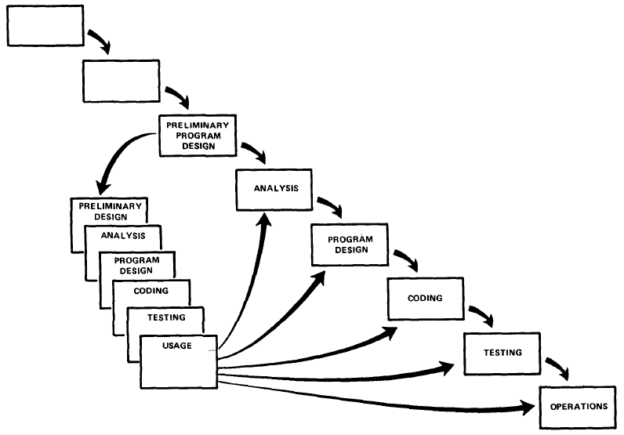
Do It Twice
If the computer program in question is being developed for the first time, attempt to do the job twice - the first result provides an early simulation of the final product.
This process is done in miniature, to a time scale that is relatively small with respect to the overall effort.

Slide 14
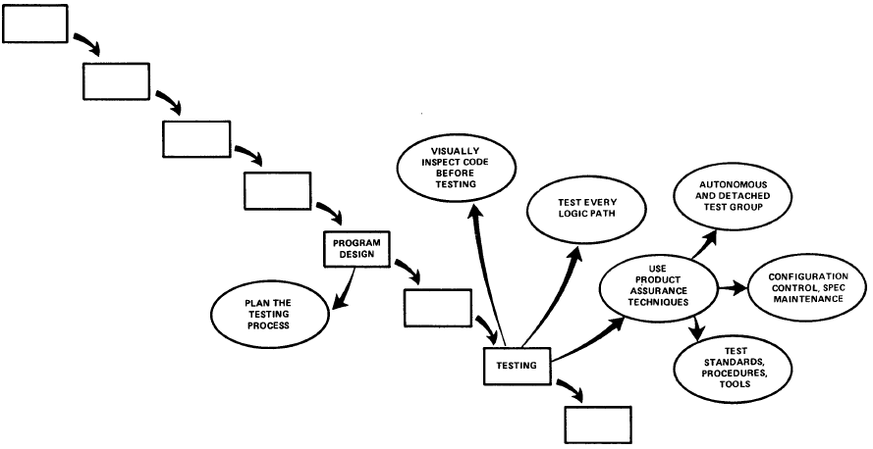
Plan, Control and Monitor Testing
This step will uncover the majority of coding errors although it is difficult for large systems.

Slide 15
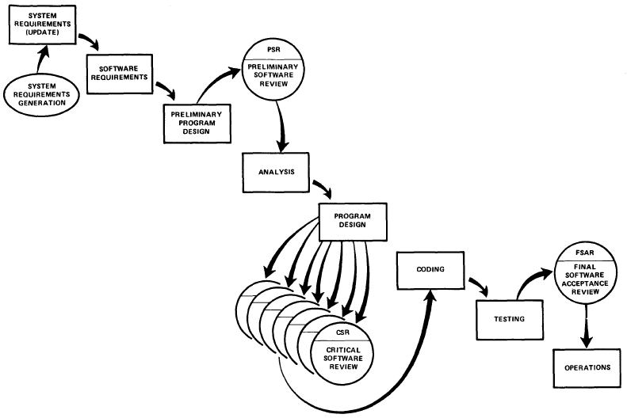
Involve the Customer
To give the contractor free rein between requirement definition and operation is inviting trouble.
The insight, judgment, and commitment of the customer can bolster the development effort.
The involvement should be formal, in-depth and continuing.

Slide 16
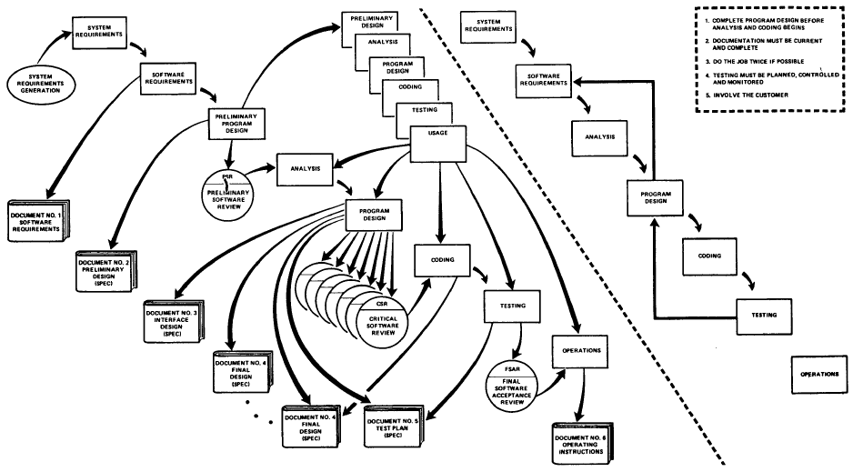
Managing the Development of Large Software Systems
If the relatively simpler process without the five complexities described here would work successfully, then of course the additional money is not well spent.
The simpler method has never worked on large software development efforts and the costs to recover far exceeded those required to finance the five-step process listed.

Slide 17

(Winston Royce’s) Waterfall Model
The (Winston Royce’s) successful waterfall model is a SDLC model that has the following characteristics:
It consists of definite phases that are executed in sequence.
There are tangible deliverables produced at the end of each phase.
The phases be revisited but the overall cycle is completely executed no more than 2 times. If executed more than once, the first cycle is for a simulation.
Once design begins, a formal change-control process is used.
The process is document-driven.

Slide 18

Waterfall Model Pros & Cons
Limit risk to an affordable sum.
Minimize effort spent on unproductive or undesired directions.
Avoid the possibility of losing control of a project.
Its emphasis on fully elaborated documents as completion criteria for early requirements and design phases.
Document-driven standards have pushed many projects to write elaborate specifications of poorly understood user interfaces and decision support functions, followed by the design and development of large quantities of unusable code.
In real life there is a need to initiate software design and coding, and hardware modeling, earlier in the project cycle to ensure that user requirements are understood and to prove technical feasibility.

Slide 19
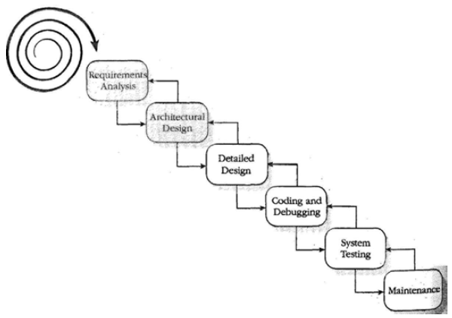
Waterfall with Risk-Reduction [3]
Risk Reduction
Risk Reduction
Develop a user-interface prototype
Use system storyboarding
Conduct user interviews
Videotape users interacting with an older system
It requires more effort.

Slide 20
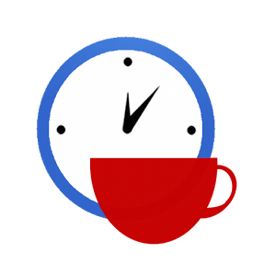

Slide 21
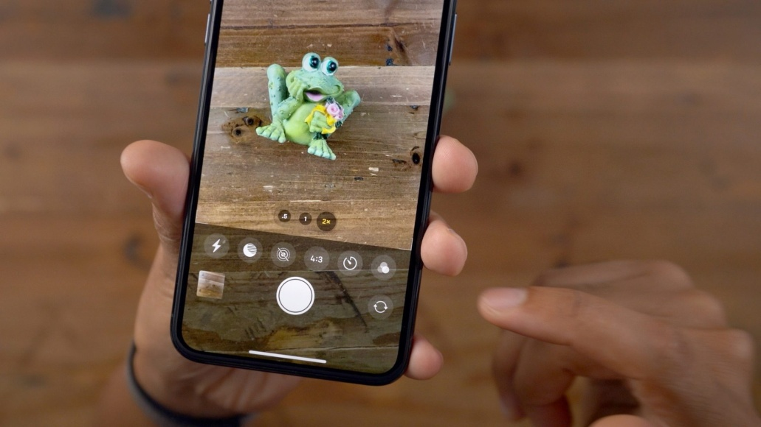

Customer Confidence
When will I receive my product?
How will it look like?
Will it be usable?
Deliver business values to client fast and repeatedly.
Gives customers a chance to “try software” periodically and provide feedback.

Slide 22
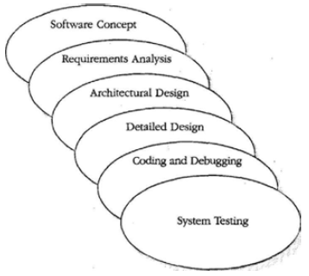
Sashimi Model
Most of the weaknesses in the pure waterfall model arise not from problems with these activities but from the treatment of these activities as disjoint, sequential phases.
The traditional waterfall model allows for minimal overlapping between phases at the end-of-phase review.
This model suggests a stronger degree of overlap.
Milestones are more ambiguous. It’s harder to track progress accurately.
Performing activities in parallel can lead to miscommunication, mistaken assumptions, and inefficiency.

Slide 23
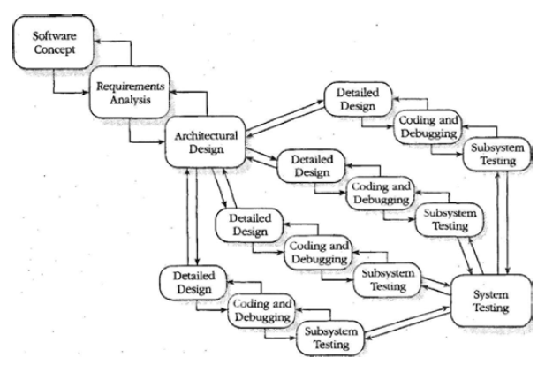
Waterfall with Subprojects
Why delay the implementation of the areas that are easy to design just because we're waiting for the design of a difficult area? If the architecture has broken the system into logically independent subsystems, you can spin off separate projects, each of which can proceed at its own pace.
The main risk with this approach is unforeseen interdependences.

Slide 24
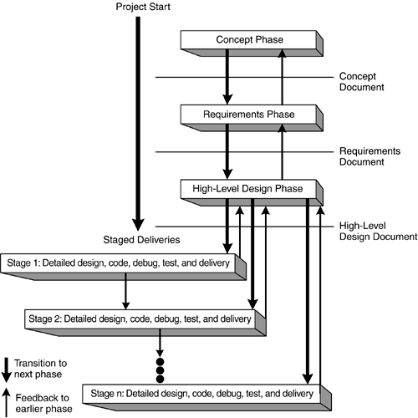
Staged Delivery
The staged-delivery is a model in which you show software to the customer in successively refined stages.
Must account for all technical dependencies between different components of the product.
Integration cost.
Avoid problem of no part of the system being done until all is done.
Provide tangible signs of progress earlier.

Slide 25
Real World Waterfall Model: A New System
High level requirements
High level design (with prototypes and PoC)
Full architecture and low level design
First plan and estimation (first contract)
Plan and schedule (full contract)
Implementation/Unit testing (staged delivery if possible)
Detailed requirements and test cases
System testing (staged delivery if possible)
Production

Slide 26
Real World Waterfall Model: System Maintenance
High level requirements
Current system understanding (with prototypes and PoC)
Revised architecture and low level design
First plan and estimation (first contract)
Plan and schedule (full contract)
Implementation/Unit testing (staged delivery if possible)
Detailed requirements and test cases
System testing (staged delivery if possible) and pilot
Production

Slide 27

When To Use Waterfall Model?
Cost and time are clear and fixed.
Objectives are clear, reliable and fixed.
Requirements can be specified and are not ambiguous.
Technology is understood.
Resources (with expertise) are available.
Similar projects exist.
Existing (maintenance) system should be available at the beginning.

Slide 28



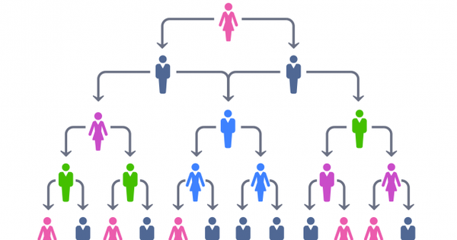
Actually, Waterfall is Often Used When
Bureaucracy management style
Low supplier development transparency
Low customer engagement

Slide 30
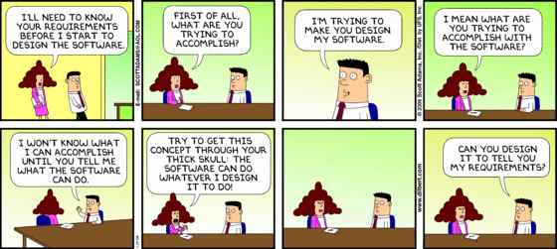
Requirements Gathering
I can’t tell you what I want, but I’ll know it when I see it.

Slide 31


Software Changes
Software Development is more like New Product Development than Manufacturing
The requirements change.
The design changes.
The business changes.
The technology changes.
The team changes.
The team members change.
Uncertainty and Unknown Variables
The problem isn't change, because change is going to happen; the problem, rather, is our inability to cope with change.

Slide 32
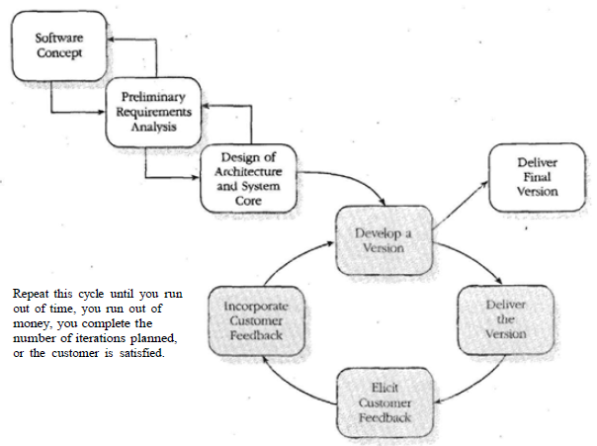
Evolutionary Delivery
Evolutionary delivery is a lifecycle model in which you develop a version of your product, show it to your customer, and refine the product based on customer feedback.
Your initial emphasis is on the core of the system, which consists of lower level system functions that are unlikely to be changed by customer feedback.
HOW? – IID

Slide 33
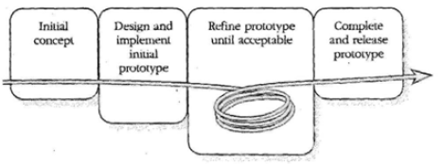
Evolutionary Prototyping Model
Evolutionary prototyping is a lifecycle model whose stages consist of expanding increments of an operational software product, with the directions of evolution being determined by operational experience.
HOW? – IID
Begin by developing the most visible aspects of the system.
Demonstrate that part of the system to the customer and then continue to develop die prototype based on the feedback you receive.
At some point, you and the customer agree that the prototype is "good enough."
At that point, you complete any remaining work on the system and release the prototype as the final product.

Slide 34
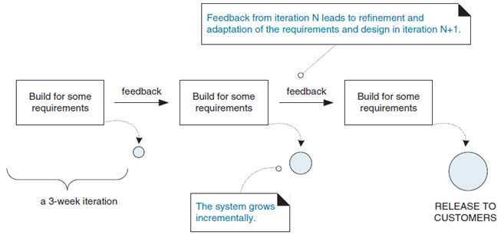
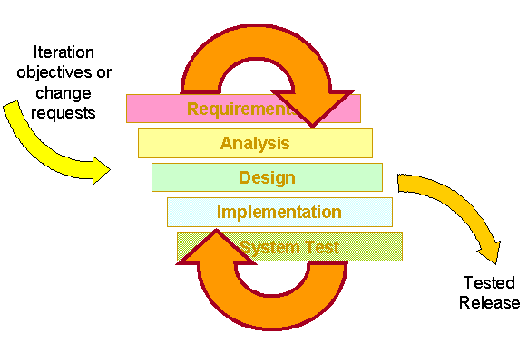
Iterative and Incremental Development [4]
Iterative and incremental development is an approach to building software in which the overall lifecycle is composed of several iterations in sequence and system functionality are sliced into increments (portions).
Each iteration is a self-contained mini-project composed of activities such as requirements analysis, design, programming, and test.
The goal for the end of an iteration is an iteration release, a stable, integrated and tested partially complete system.

Slide 35
Incremental Delivery
Incremental delivery is the practice of repeatedly delivering a system into production (or the marketplace) in a series of expanding capabilities.
Increment 5
Increment 1
Increment 4
Increment 2
Increment 3
A product

Slide 36
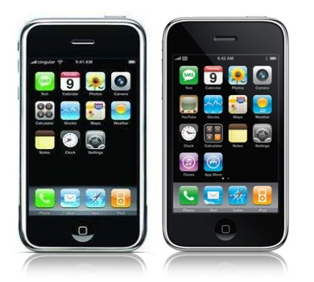

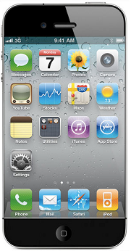
Evolutionary Delivery
Evolutionary delivery is a refinement of the practice of incremental delivery in which there is a vigorous attempt to capture feedback regarding the installed product, and use this to guide the next delivery.
A property of a product

Slide 37
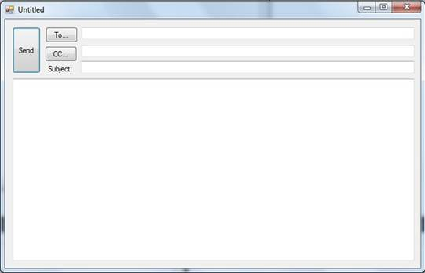
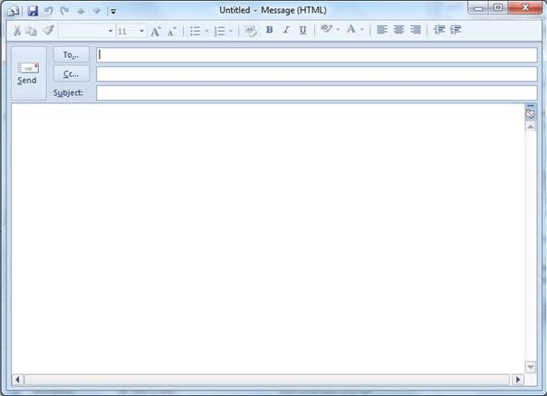
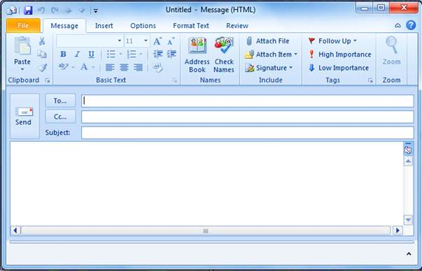
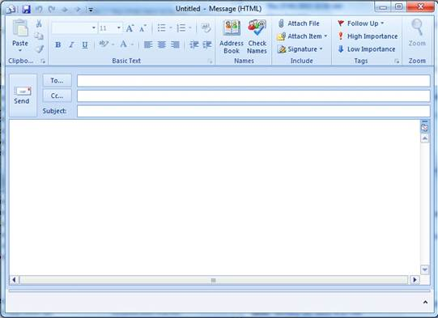
Incremental Evolutionary Delivery
Add, revise and improve parts of the system.
Add, revise and improve parts of the system.
Add, revise and improve parts of the system.

Slide 38
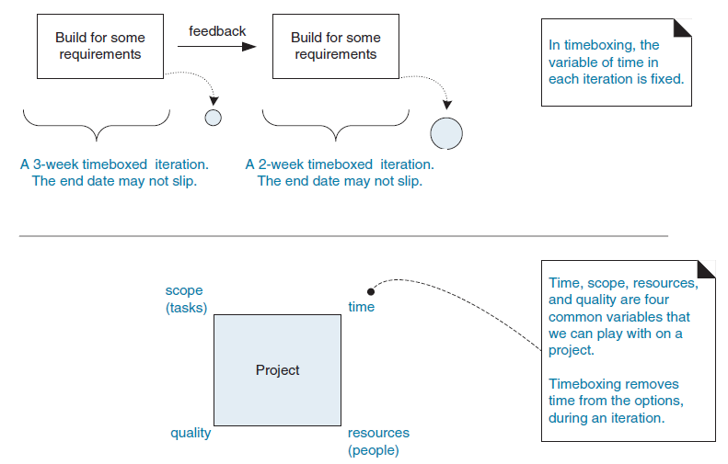
Time-boxed Iterative Development
Iteration time-boxing is the practice of fixing the iteration end date and not allowing it to change.

Slide 39
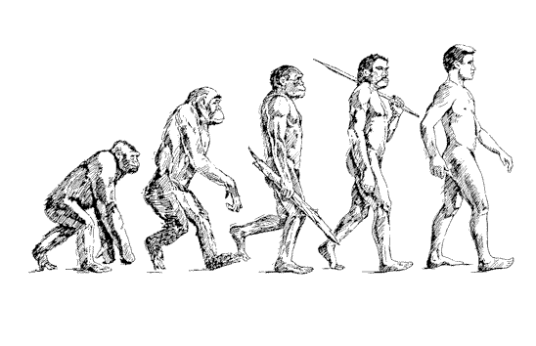
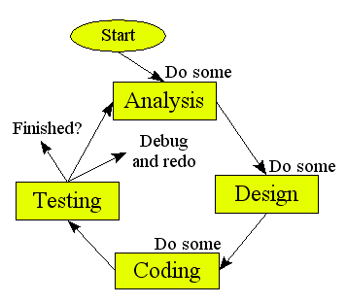
Evolutionary Iterative Development (IID)
Evolutionary iterative development implies that the requirements, plan, estimates, and solution evolve or are refined over the course of the iterations, rather than fully defined and "frozen" in a major up-front specification effort before the development iterations begin.

Slide 40
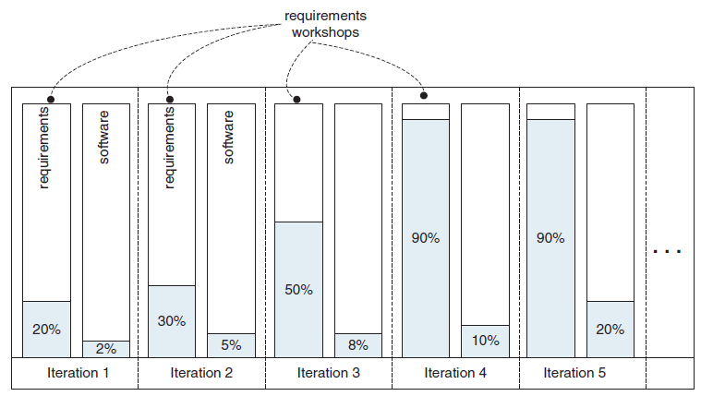
Evolutionary And Iterative Requirements Engineering
Are the requirements forever unbounded or always changing at a high rate?
20-iteration project. Most requirements will be discovered and refined within the first four iterations

Slide 41
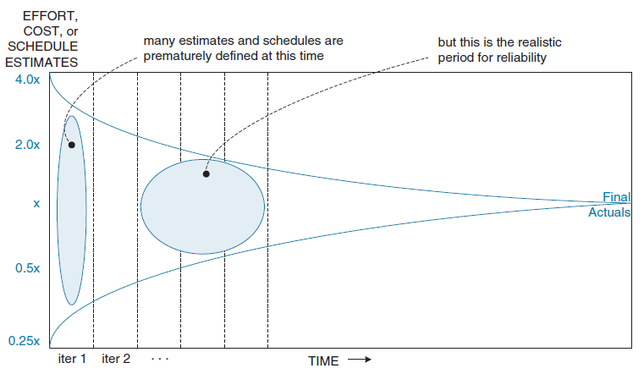
Evolutionary and Adaptive Planning
Are the estimates and schedules are forever unbounded or unknown?
132 days
33 days
8 days
Cone of Uncertainty

Slide 42

Pros & Cons of IID
Requirements are changing rapidly.
Customer is reluctant to commit to a set of requirements.
Neither you nor your customer understands the application area well.
Developers are unsure of the optimal architecture or algorithms to use.
Steady, visible signs of progress.
It's impossible to know at the outset of the project how long it will take to create an acceptable product.
It’s hard for several independently evolved applications to be integrated.
It's easy to evolve a lot of hard-to-change code before addressing long-range architectural and usage considerations.

Slide 43
Real World IID Model: A New System
High level requirements
High level design (with PoC/prototype)
Waterfall 2: a maintenance system (partial production if possible)
First plan and estimation (flexible contract)
…
Waterfall 1: a new system (partial production if possible)
Full production
Waterfall n: a maintenance system (partial production if possible)
…

Slide 44
Real World IID: System Maintenance
High level requirements
Current system understanding (with PoC/prototype)
Waterfall 2: a maintained system (partial production if possible)
First plan and estimation (flexible contract)
…
Waterfall 1: a maintained system (partial production if possible)
Full production
Waterfall n: a maintained system (partial production if possible)
…

Slide 45
When To Use IID Model?
Cost and time are flexible.
Objectives are clear but not fixed.
Requirements cannot be specified (without system implementation) or are ambiguous.
Technology is new.
Resources (with expertise) are not available.
Similar projects do not exist.
Existing (maintenance) system may not be available at the beginning.

Slide 47
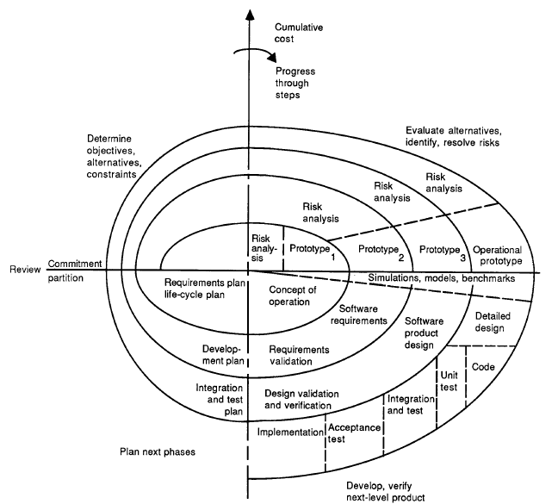
Spiral Model [5, 6]
The radial dimension represents the cumulative cost incurred in accomplishing the steps to date.
The angular dimension represents the progress made in completing each cycle of the spiral.
The risks are categorized as performance (or user interface) related risks or development risks.

Slide 48
Start
Each cycle of the spiral begins with the identification of
the objectives of the portion of the product being elaborated (performance, functionality, ability to accommodate change, etc.);
the alternative means of implementing this portion of the product (design A , design B, reuse, buy, etc.); and
the constraints imposed on the application of the alternatives (cost, schedule, inter-face, etc.).
1

Slide 49
Risk Analysis
Evaluate the alternatives relative to the objectives and constraints.
Identify areas of uncertainty that are significant sources of project risk.
If so, the next step should involve the formulation of a cost-effective strategy for resolving the sources of risk. This may involve prototyping, simulation, benchmarking, reference checking, administering user questionnaires, analytic modelling.
2

Slide 50
Another Prototype
If performance or user-interface risks strongly dominate program development or internal interface-control risks, the next step may be an evolutionary development one: a minimal effort to specify the overall nature of the product, a plan for the next level of prototyping, and the development of a more detailed prototype to continue to resolve the major risk issues.
2
4
3

Slide 51
Series of Evolutionary Prototypes
If this prototype is operationally useful and robust enough to serve as a low-risk base for future product evolution, the subsequent risk-driven steps would be the evolving series of evolutionary prototypes going toward the right of the figure.
In this case, the option of writing specifications would be addressed but not exercised. Thus, risk considerations can lead to a project implementing only a subset of all the potential steps in the model.

Slide 52
Waterfall Approach
On the other hand, if previous prototyping efforts have already resolved all of the performance or user-interface risks, and program development or interface-control risks dominate, the next step follows the basic waterfall approach (concept of operation, soft-ware requirements, preliminary design, etc.), modified as appropriate to incorporate incremental development.
Each level of software specification in the figure is then followed by a validation step and the preparation of plans for the succeeding cycle.

Slide 53
Review
Each cycle is completed by a review involving the primary people or organizations concerned with the product.
The plans for succeeding phases may also include a partition of the product into increments for successive development or components to be developed by individual organizations or persons.

Slide 54
Initiating and Terminating the Spiral
The spiral gets started by a hypothesis that a particular operational mission (or set of missions) could be improved by a software effort.
The spiral process then involves a test of this hypothesis: at any time, if the hypothesis fails the test the spiral is terminated.
Otherwise, it terminates with the installation of new on modified software, and the hypothesis is tested by observing the effect on the operational mission.

Slide 55

Spiral Model
The spiral model is a software development process that uses a risk-driven approach to the software process rather than a primarily document-driven or code-driven process.
2
1
Risk resolution
4
3
Barry Boehm

Slide 56
Spiral Model Definition [7]
The spiral development model is a risk-driven process model generator.
It is used to guide multi-stakeholder concurrent engineering of software intensive systems.
It has two main distinguishing features.
One is a cyclic approach for incrementally growing a system's degree of definition and implementation while decreasing its degree of risk.
The other is a set of anchor point milestones for ensuring stakeholder commitment to feasible and mutually satisfactory system solutions.

Slide 57
A Process Model Generator
A process model answers two main questions:
What should be done next?
For how long should it continue?
Under the spiral model the answers to these questions are driven by risk considerations and vary from project to project and sometimes from one spiral cycle to the next.
Each choice of answers generates a different process model.
At the start of a cycle, all of the project’s success-critical stakeholders must participate concurrently in reviewing risks and choosing the project’s process model accordingly.

Slide 58
Anchor Point Milestones
A major difficulty of the original spiral model was its lack of intermediate milestones to serve as commitment points and progress checkpoints.
This difficulty has been remedied by the development of a set of anchor point milestones: Life Cycle Objectives (LCO), Life Cycle Architecture (LCA), and Initial Operational Capability (IOC).
These can be described as stakeholder commitment points in the software life cycle: LCO is the stakeholders’ commitment to support architecting; LCA is the stakeholders' commitment to support full life cycle; and IOC is the stakeholders' commitment to support operations.

Slide 59
Life Cycle Objectives (LCO) & Life Cycle Architecture (LCA)
Definition of Operational Concept
System Prototype(s)
Definition of System Requirements
Definition of System & Software Architecture
Definition of Life-Cycle Plan
Feasibility Rationale
Their focus is not on requirements snapshots or architecture point solutions, but on requirements and architectural specifications which anticipate and accommodate system evolution. This is the reason for calling them the "Life Cycle" Objectives and Architecture milestones.

Slide 60
Initial Operational Capability (IOC)
The Initial Operational capability (IOC) is the first the users will see of a functioning system.
Software preparation, including both operational and support software with appropriate commentary and documentation; data preparation or conversion.
Site preparation, including facilities, equipment, supplies, and COTS vendor support arrangements.
User, operator and maintainer preparation, including selection, teambuilding, training and other qualification for familiarization, usage, operations, or maintenance.

Slide 61
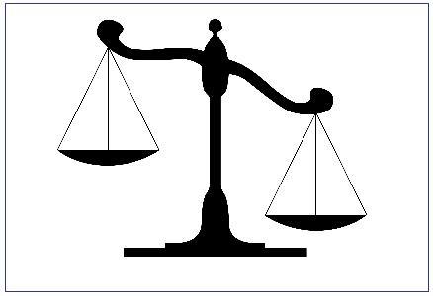
Pros & Cons of Spiral Model
Very flexible
It is more able to cope with the (nearly inevitable) changes
Takes a pro-active stance on risks with explicit risk analysis assessment and resolving stage
Complex and time consuming
Only intended for internal projects (inside a company), because risk is assessed as the project is developed.
Spiral model is risk driven. Therefore it requires knowledgeable staff.
Suitable for only large scale software development. It does not make sense if the cost of risk analysis is a major part of the overall project cost.

Slide 63
Vee-Model Introduction [8]
In real life there is a need to initiate software design and coding, and hardware modeling, earlier in the project cycle to ensure that User Requirements are understood and to prove technical feasibility.
Spiral model attempts to resolve the above deficiency by addressing the need for early feasibility modeling (“prototyping”) to identify risks and define appropriate action.
The system engineering role is still obscured.

Slide 64
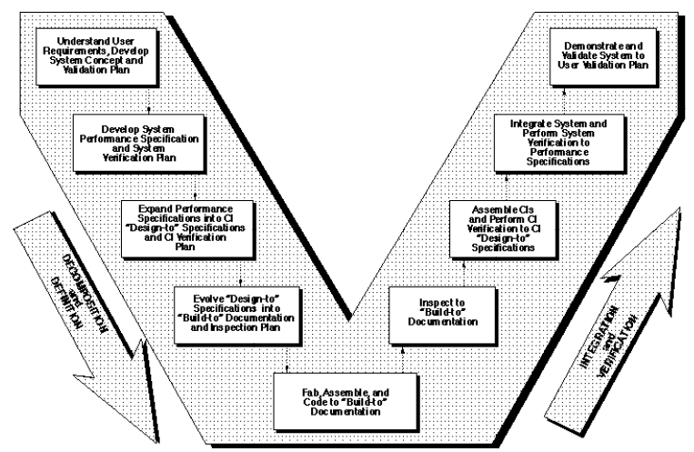
Vee-Model Overview

Slide 65
Nine Phases
Understand user requirements, develop system concept and validation plan
Develop system performance specification and system verification plan
Expand system performance specification into CI “Design-to” specifications and CI verification plan
Evolve “Design-to” specifications into “Build-to” documentation and inspection plan
Fabricate, assemble and code to “Build-to” documentation
Inspect to “Build-to” documentation
Assemble CIs and perform CI verification to CI “Design-to” specifications
Integrate system and perform system verification to performance specification
Demonstrate and validate system to user validation plan

Slide 66
The “Vee” Chart
V-model is a software development model in which the technical aspect of the project cycle is envisioned as a “Vee,” starting with User needs on the upper left and ending with a User-validated system on the upper right.
On the left side of the chart, Decomposition and Definition descends as in the waterfall model.
However, Integration and Verification flows up and to the right as successively higher levels of assemblies, units, components, and subsystems are verified, culminating at the system level.
The substantial advance in visualization of the technical aspect of the project cycle, and the role of system engineering, is gained by understanding the comprehensive “Vee” chart.

Slide 67
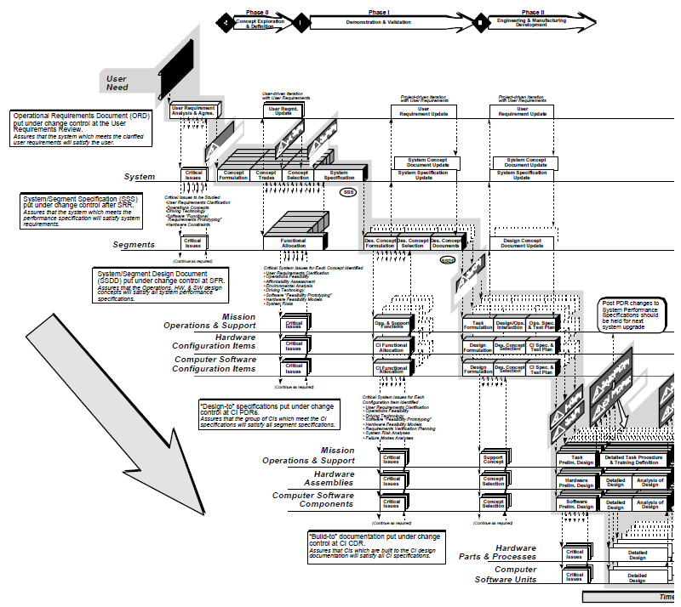

Slide 68
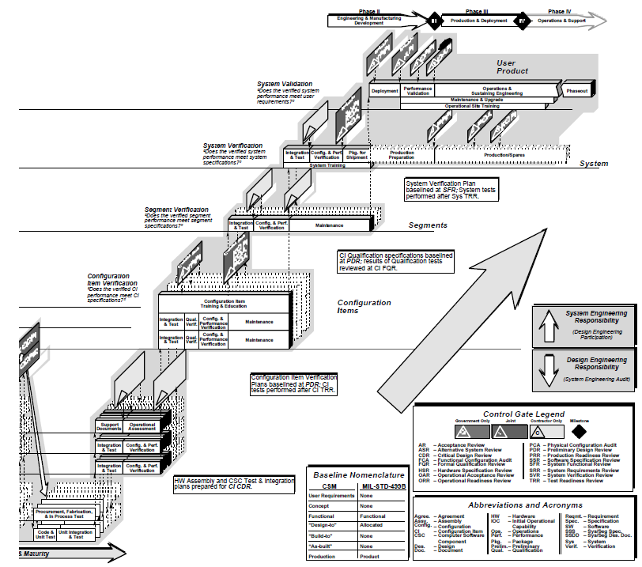

Slide 69
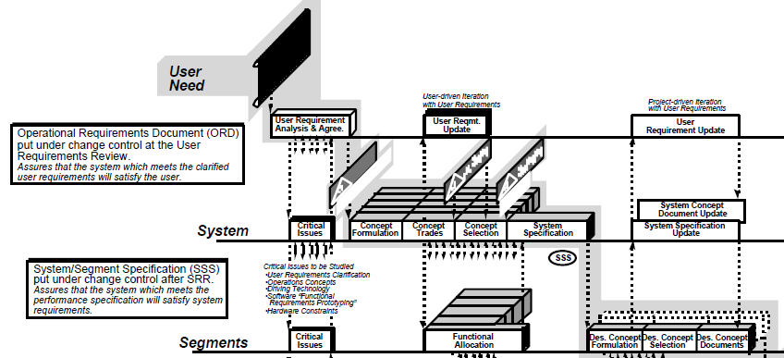
Segments and Configuration Items
At each level, moving into the depth of the paper (perpendicular to the surface) there are a number of parallel boxes illustrating that there may be many Segments or Configuration Items that make up the system at that level of decomposition.

Slide 70
Alternate Concepts
Also at the System level, on the left of the chart, the number of parallel boxes illustrates that alternate concepts should be evaluated to determine the best solution for the User’s needs. At the System Requirements Review (SRR), the choice is approved and a single concept is base-lined for further definition.

Slide 71
Baselines and Control Gates
As project development progresses, a series of six baselines are established to systematically manage cohesive system development. Each of the baselines is put under formal Configuration Management at the time they are approved.
The Control Gates define significant decision points in the project cycle.

Slide 72
Six Baselines
“User Requirements Baseline” established by the System Requirement Document approved and put under Configuration Management prior to the System Requirements Review (SRR).
“Concept Baseline” established by the Concept Definition section of the Integrated Program Summary document at the SRR.
“System Performance Baseline” (or Development Baseline) established by the System Performance Specification at the System Design Review (SDR).
“‘Design-To’ Baseline” (or Allocated Baseline) established at the series of Preliminary Design Reviews (PDRs).
“‘Build-To’ Baseline” (or preliminary Product Baseline) established at the series of Critical Design Reviews (CDRs).
“‘As-Built’ Baseline” (or Production Baseline) established at the series of Formal Qualification Reviews (FQRs).

Slide 73
Off-core Activities
The left side of the core of the “Vee” (the shaded area) follows the well-established waterfall model for the project cycle.
As the project progresses, detailed analyses, risk identification, and risk reduction modeling continues. This is shown on the chart by the vertical and descending off-core activities.

Slide 74
Off-core Activities Repeat
While technical feasibility decisions are made in the off-core activities only decisions at the core-level are put under Configuration Management at the various Control Gates.
The off-core work is not formally controlled, and will be repeated at the appropriate level to prepare justification for introduction into the baseline definition.

Slide 75
Downward Iteration
The multiple arrows descending from the bottom of the left side of the core of the “Vee” indicate that there can, and should be, sufficient iteration downward to establish feasibility and to identify and quantify risks.

Slide 76
Upward Iteration
Upward iteration with User Requirements (and levels leading to them) is permitted, but should be kept to a minimum unless the user is still generating requirements. The User needs to be cautioned that changes in requirements during the development process will cause positive or negative changes in the predicted cost and schedule.

Slide 77
Modification of User Requirements
Often in software projects upward confirmation of solutions with the User is necessary because User Requirements cannot be adequately defined at the start.
Iteration with User Requirements should be stopped at PDR.
Modification of User Requirements after PDR should be held for the next model or release. If significant changes to User Requirements must absolutely be made after PDR, then the project should be stopped and restarted at the start of a new “Vee,” reinitiating the entire process.
The repeat of the process may be quicker because of the lessons learned, but all steps must be redone.

Slide 78
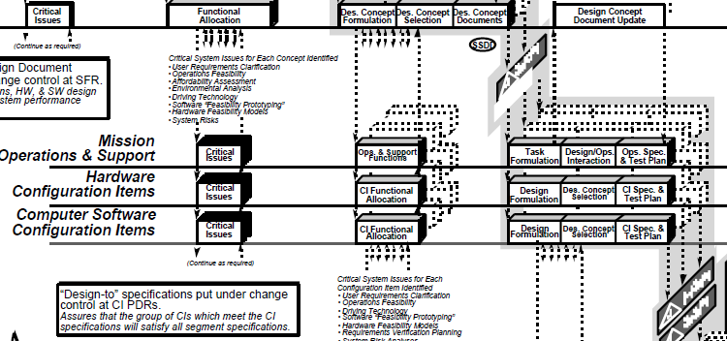
Incremental Development
If the User Requirements are too vague to permit final definition at PDR, one approach is to develop the project in predetermined incremental releases.
The first release is focused on meeting a minimum set of User Requirements, with subsequent releases providing added functionality and performance.

Slide 79
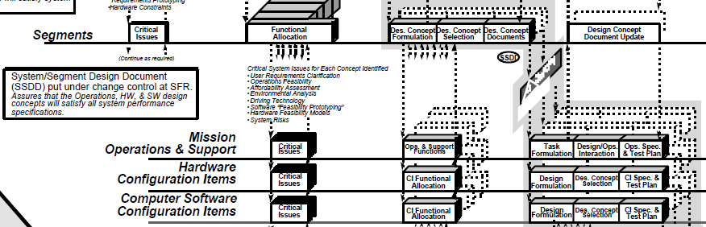
Concurrent Engineering
If high iteration with User Requirements is required after the System Design Review (SDR), it is probable that the project has passed early Control Gates prematurely, and it is not sufficiently defined.
One cause of premature advance is that the appropriate technical experts were not involved at early stages, resulting in acceptance of requirements and design concepts which cannot be built, inspected, and/or maintained.

Slide 80
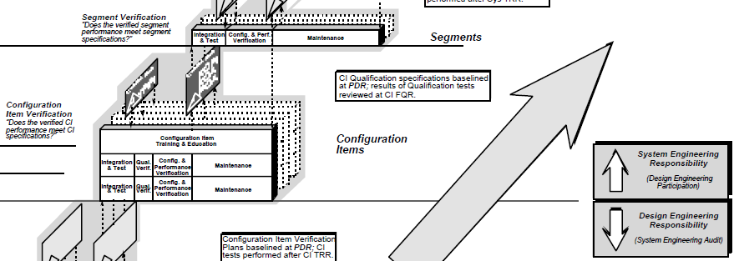
Role of System Engineering
Above the line System Engineering is responsible, and Design Engineering provides technical assistance. Below the line Design Engineering is responsible, and System Engineering performs technical audit.
Note that System Engineering is influential throughout the entire project life cycle, from User Requirements development to system decommissioning.

Slide 81
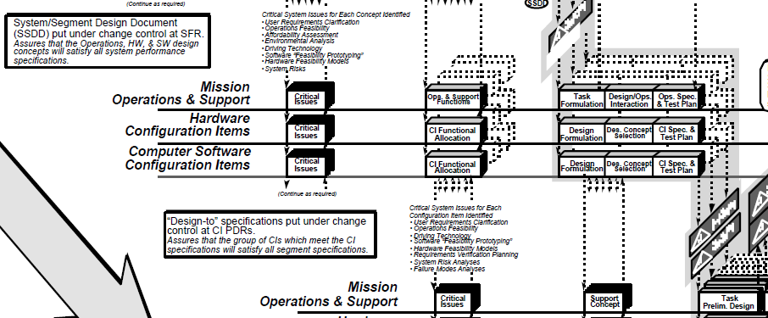
Technology Insertion
Technology development can be done in parallel with the project evolution, and inserted as late as Preliminary Design Review.
The technology development would be represented by a horizontal bar off the core, at the Configuration Item level (or below).

Slide 82
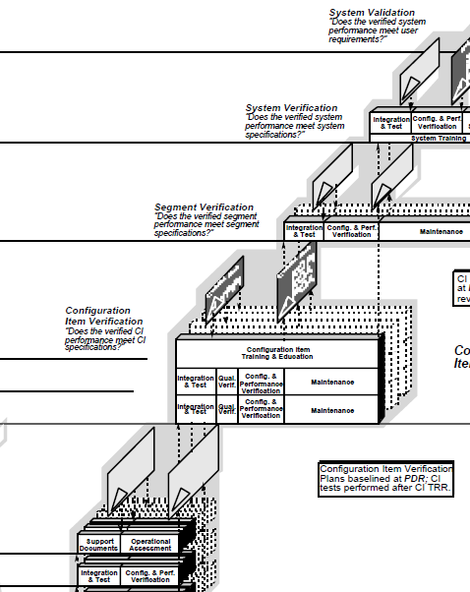
Integration and Verification
Validation is the process of demonstrating (as opposed to proving) that the product satisfies the User Needs, “regardless” of what the system specification requires (“Have we built the right system?”).
Ascending the right side of the “Vee” is the process of Integration and Verification.
At each level there is a direct correspondence between activities on the left and right sides of the chart. This is deliberate. The method of verification must be determined as the requirements are developed and documented at each level.
Verification is the process of proving that each product meets its specification (“Have we built the system right?”).

Slide 83
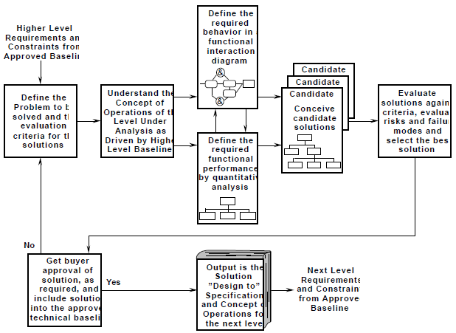
System Analysis and Design Process

Slide 84
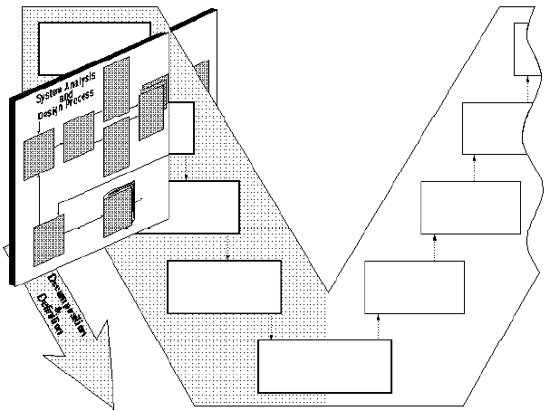
Application of the System Analysis and Design Process to the Technical Aspect of the Project Cycle
The system engineering process is repeated at every level of the cycle, and may be repeated many times within a phase.

Slide 85
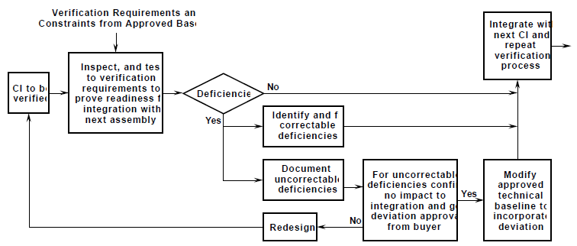
System Verification and Integration Process

Slide 86

Application of the System Verification and Integration Process to the Technical Aspect of the Project Cycle

Slide 87

System Engineering Definition
System Engineering can now be more accurately defined as the application of the System Analysis and Design Process and the Integration and Verification Process to the logical sequence of the Technical Aspect of the Project Cycle.
Emphasize baseline management and configuration control that is an essential discipline to good system management.

Slide 88

Thank You & See You Again

